Slide 1

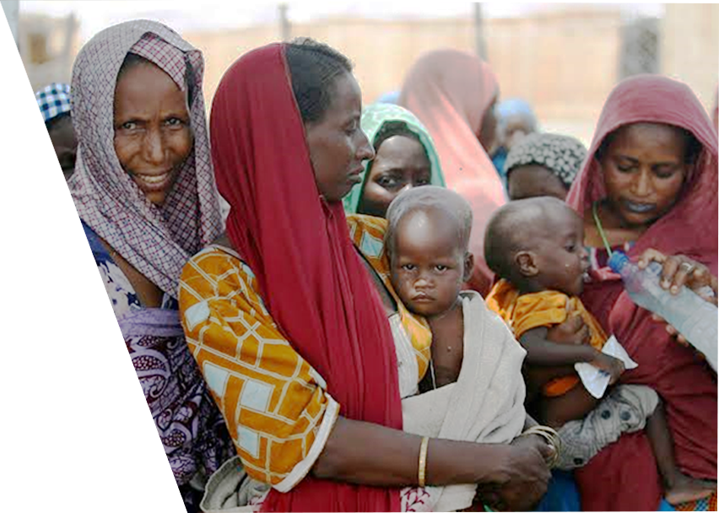

LIFE SKILL EDUCATION INITIATIVE FOR INTERNALLY DISPLACED PERSONS’ (LIID)
BROOKS INSIGHTS

Slide 2


The objectives of the project is to;
BROOKS INSIGHTS
INTRODUCTION
According to UN Agenda for 2030, SDG will address vulnerable groups like Internally Displaced Persons’ (IDPs’), thereby not leaving them behind. This implies immediate and long term effort to empower and prepare them for what is to come.
Implement Life Skill Education (LSE) Intervention curriculum for IDPs’
Evaluate the efficiency of LSE Intervention
Compare delivery modes in two different camps.
Fig1: LIID project to meet SDG requirements

Slide 3
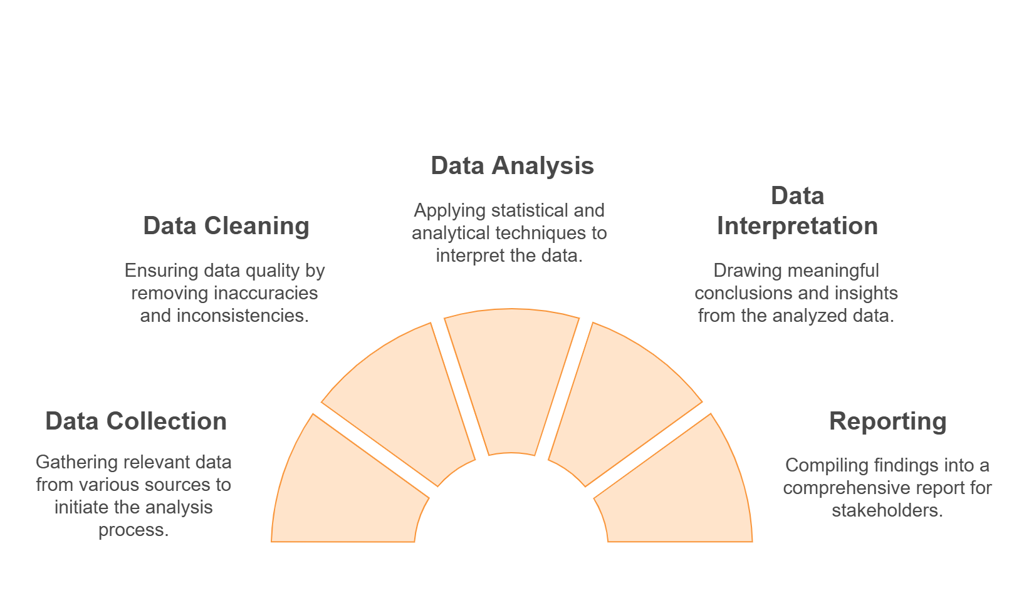
BROOKS INSIGHTS
APPROACH
A survey containing 12 life skills, acceptability and appropriateness of intervention, was administered to 224 IDPs’ in two different camps in FCT, Abuja(99 respondents in Duur and 125 respondents in Sawa).
Method of delivery was in-person and mobile Telegram respectively.
Response were noted and analyzed with python programming language.
The 12 LSE domains were critically inspected and inferences were drawn.
Comparison of the delivery modes was carried out using t-test.
Fig2: Approach to Reporting LIID Project

Slide 4
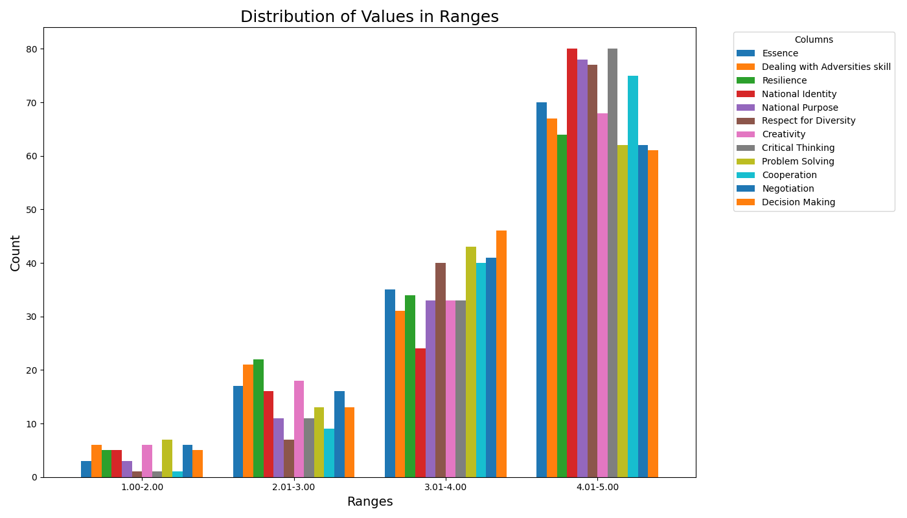
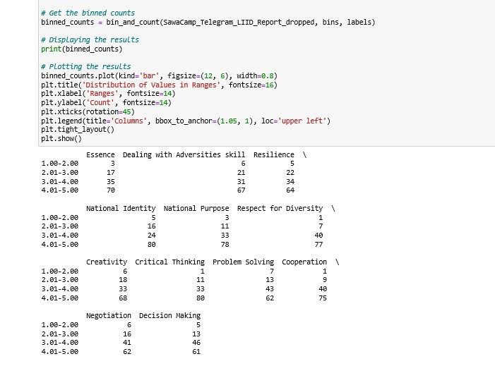
BROOKS INSIGHTS
RESULTS
Individual Domain Scoring
A scoring range of (1.00-2.00=low, 2.01-3.00=moderate, 3.01-4.00=high and 4.01-5.00=Very high) was adopted for measuring respondents self efficacy.
Sawa camp (mobile delivery via Telegram) has higher population with low and moderate self efficacy scores in the 12 skills domain compared to Duur camp. (Fig.3,4,6)
Problem solving, Resilience, Dealing with adversities exhibit a high population in the low and moderate score range at Sawa camp. (Fig.3)
Fig 3: Domain score distribution in Sawa camp ( Telegram)
Fig 4: Python code snippet for Domain score category (Sawa camp)

Slide 5
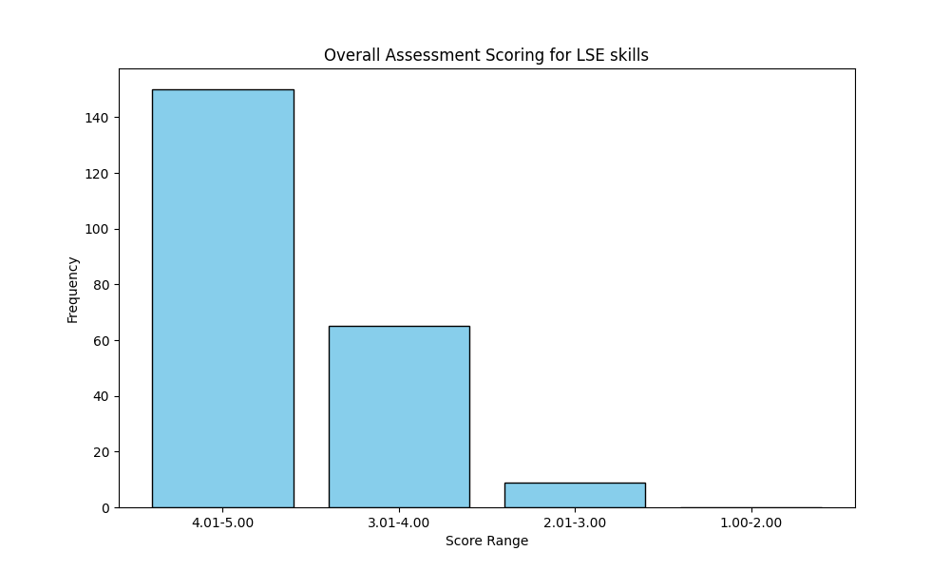
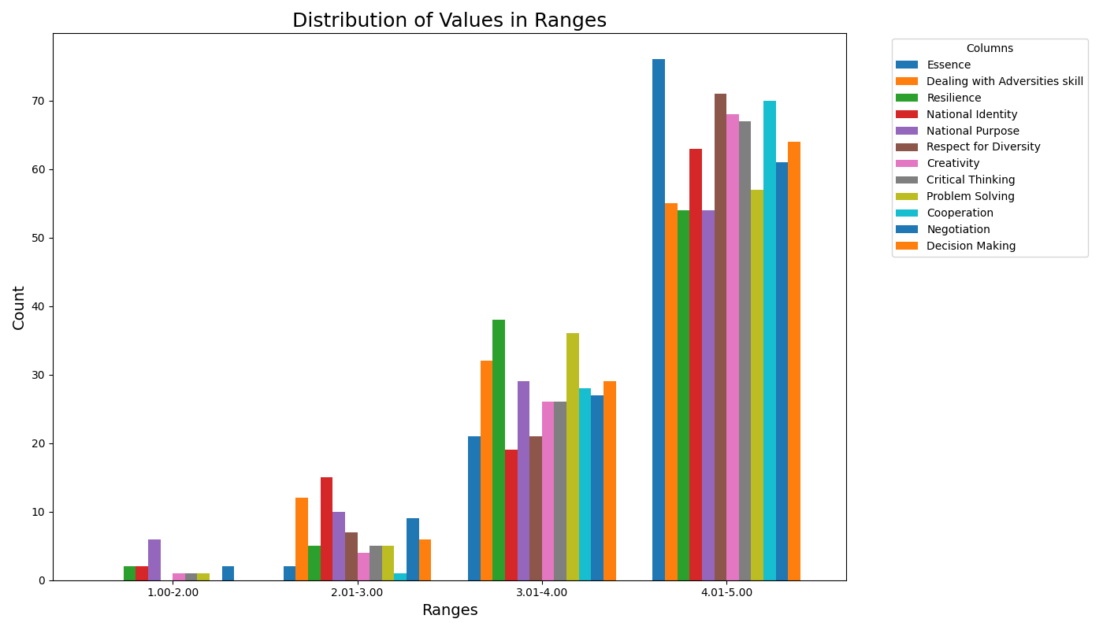
BROOKS INSIGHTS
RESULTS
Overall Assessment Scoring
Overall assessment excludes low efficacy score across domain, therefore it isn’t effective in inspecting individual domain. (Fig.5)
85% of domain in the low and moderate self efficacy group have fewer than 5 respondents. (Fig.6)
National Purpose, National Identity, Dealing with adversities etc. exhibits fairly high population in the low and moderate score range at Duur camp. (Fig.6)
Fig 5: Domain score distribution in Durr camp ( in-person)
Fig 6: Domain score distribution in Durr camp ( in-person)

Slide 6
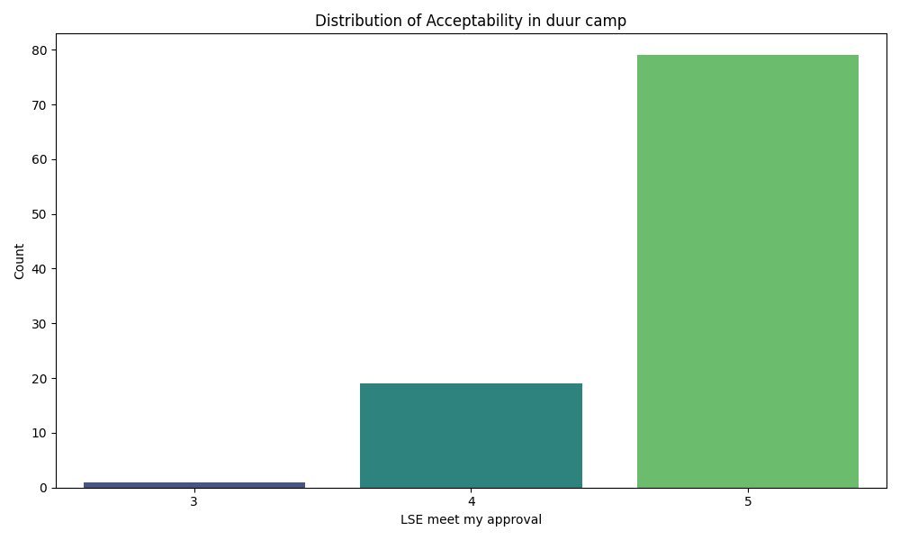
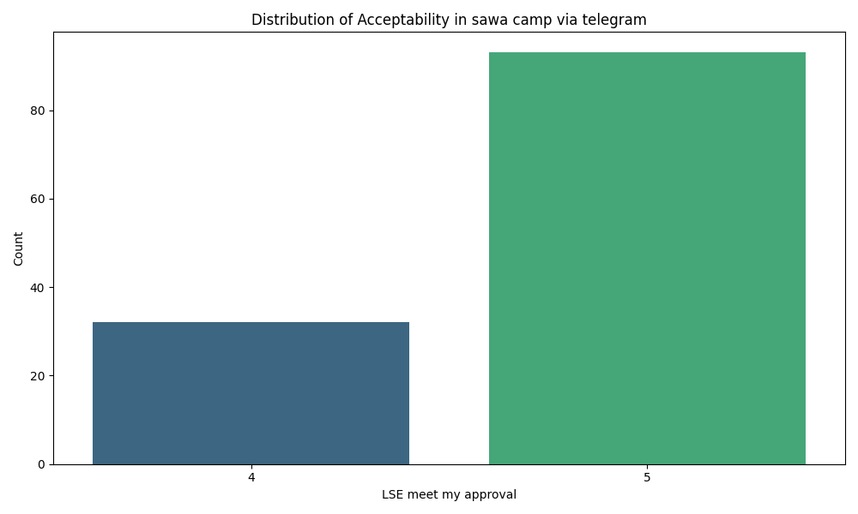
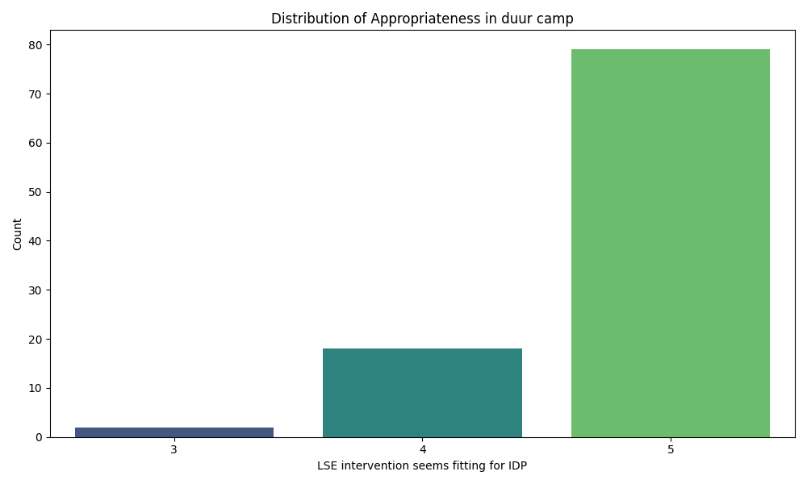
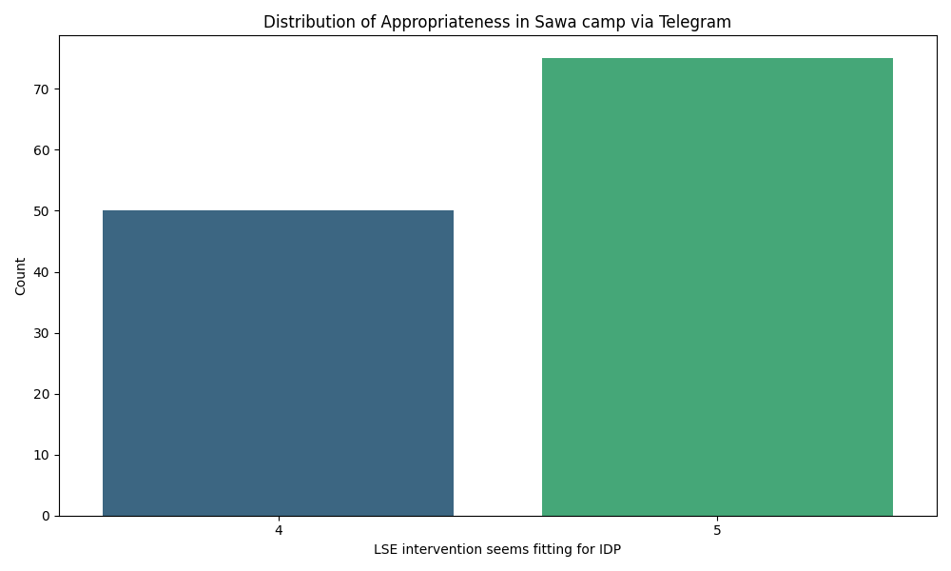
BROOKS INSIGHTS
RESULTS
Acceptability of Intervention (Fig.7)
Median score=5.0 (due to abnormal distribution)
>80% completely agree that LSE initiative is satisfactory.
Appropriateness of Intervention (Fig.8)
Fig7: Acceptability of LSE intervention in Duur and Sawa camp respectively
Median score=5.0 (due to abnormal distribution)
>80% completely agree that LSE initiative is fit to address specific issues.
T- Test between delivery modes
p-value: 0.03
Reject the null hypothesis (no difference between the delivery mode)
With 95% confidence conclude that significant difference exist between in-person and mobile delivery
Fig8: Appropriateness of LSE intervention in Duur and Sawa camp respectively
A score range of ( 1: Completely disagree, 2: Disagree, 3: Neither agree nor disagree, 4: Agree, 5: Completely agree) was adopted to measure acceptability and appropriateness of LSE intervention

Slide 7
BROOKS INSIGHTS
RECOMMENDATIONS
SAWA CAMP
Provide additional support and opportunities to build confidence.
Curriculum should be focused on Resilience, Dealing with Adversities, Problem solving etc
DUUR CAMP
Encourage application of skills, mentorship and leading roles.
Design flexible curriculum to benefit the low efficacy population.

Slide 8
Thank You for Listening
BROOKS INSIGHTS

